Slide 1


BE UNIQUE & GREEN

Slide 2






About us
We have been operating in the ice-cream and patissery industry for over 60 years; we have witnessed the market evolution and we anticipated and incorporated the changing conditions of the outside world and the resulting needs of our stakeholders, ice-cream and pastry makers.
The company’s strategy has always stood on 3 main pillars:
Our production units have evolved through the years, adapting to the ever-changing and challenging conditions. At first, the focus was plastic: a hygienic, ductile and aesthetically flexible material. Since the early 2000s, Alcas production increased the attention towards environmental and sustainability themes.
Innovation
A hallmark which has always characterized Alcas and allowed the company to be one of the main players in the market.
Design
Great importance to the product aesthetics, aiming to enhance the art and fantasy of ice-cream producers and pastry chefs;
Quality
Improvement of the quality standards in order to provide a product compliant with the most advanced regulations regarding hygiene and food safety.
In 2023, celebrating 60 years from the company foundation, we launched a new project, sign of the industrial conversion which enriched our product range with new products in a new material: the production of paper products.
One of Alcas’s strengths: a well-renowned brand among customers from all over the world, present in the market for over 60 years, as a symbol of quality and reliability.

Slide 3

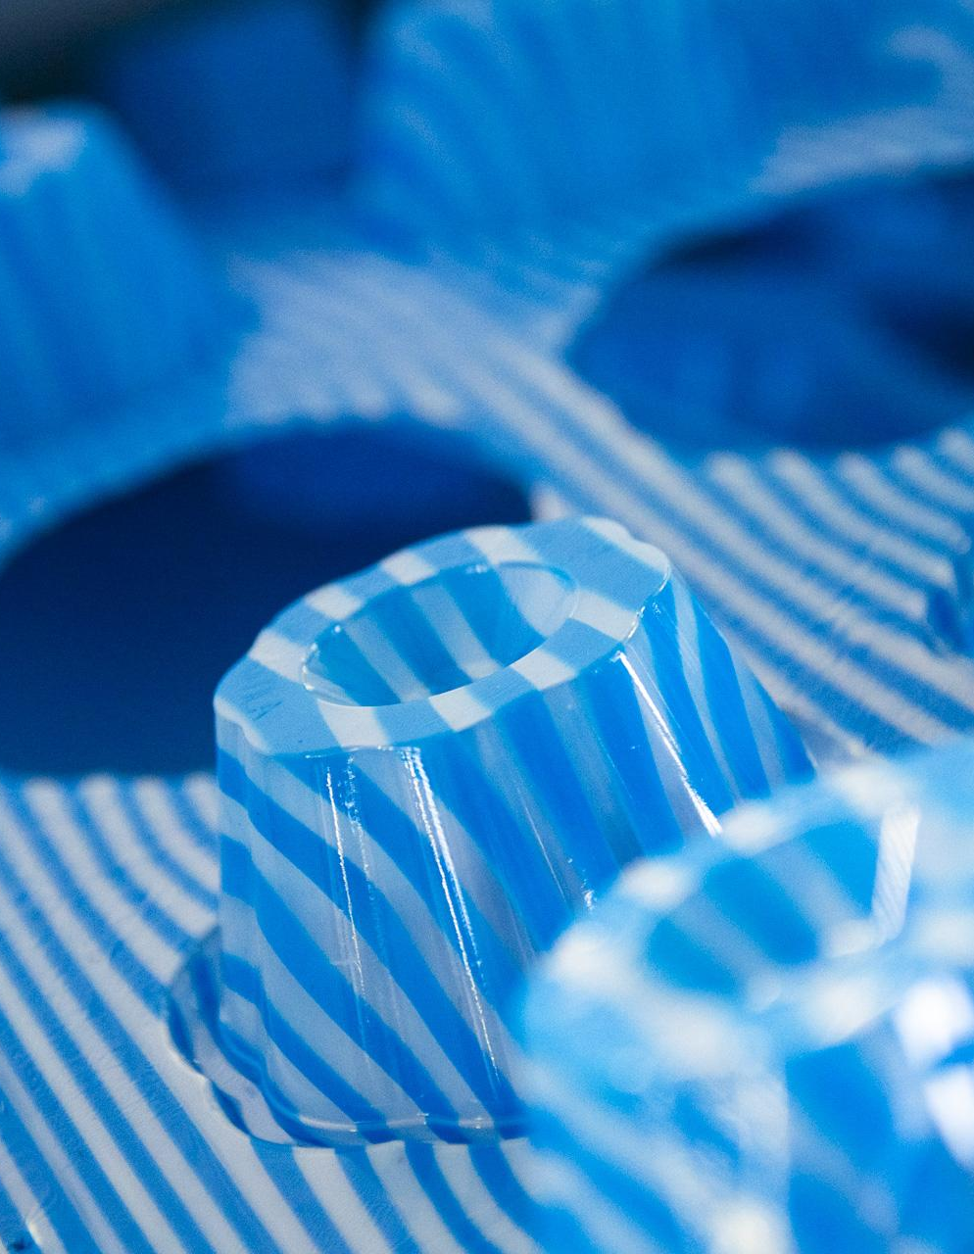
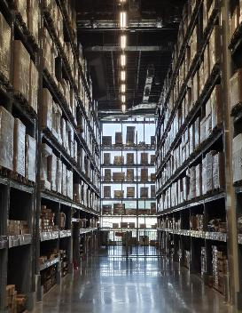
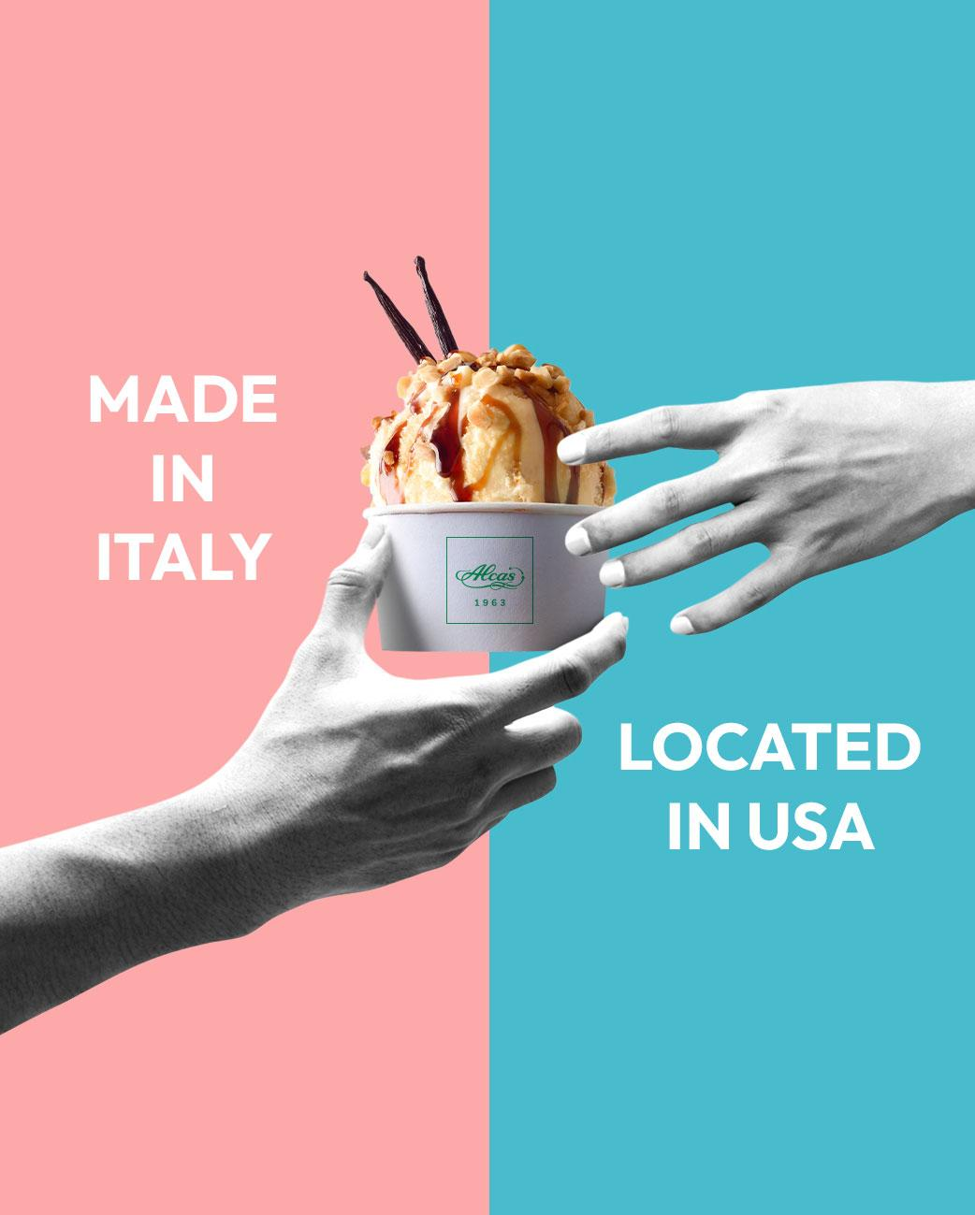
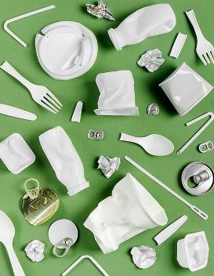


Our story
1963
1995
2012
2015
2021
2023
Aldemaro Casebasse founded the company.
Introduction of thermoforming production: a highly innovative technology for the time.
Over 7.800 square meter warehouse to guarantee a fast and efficient handling service of our products.
Opening of a branch company in Fort Lauderdale (Florida) to expand the business in the US market.
Introduction of EU directive «SUP» which led us to a transition towards alternative materials than plastic.
Introduction of paper product range, thanks to new machinery for ice cream cups and spoons.

Slide 4
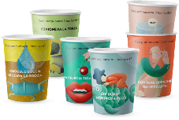
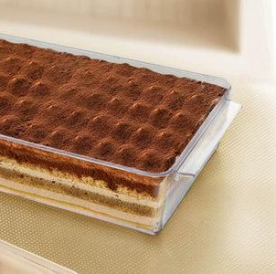

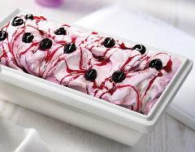
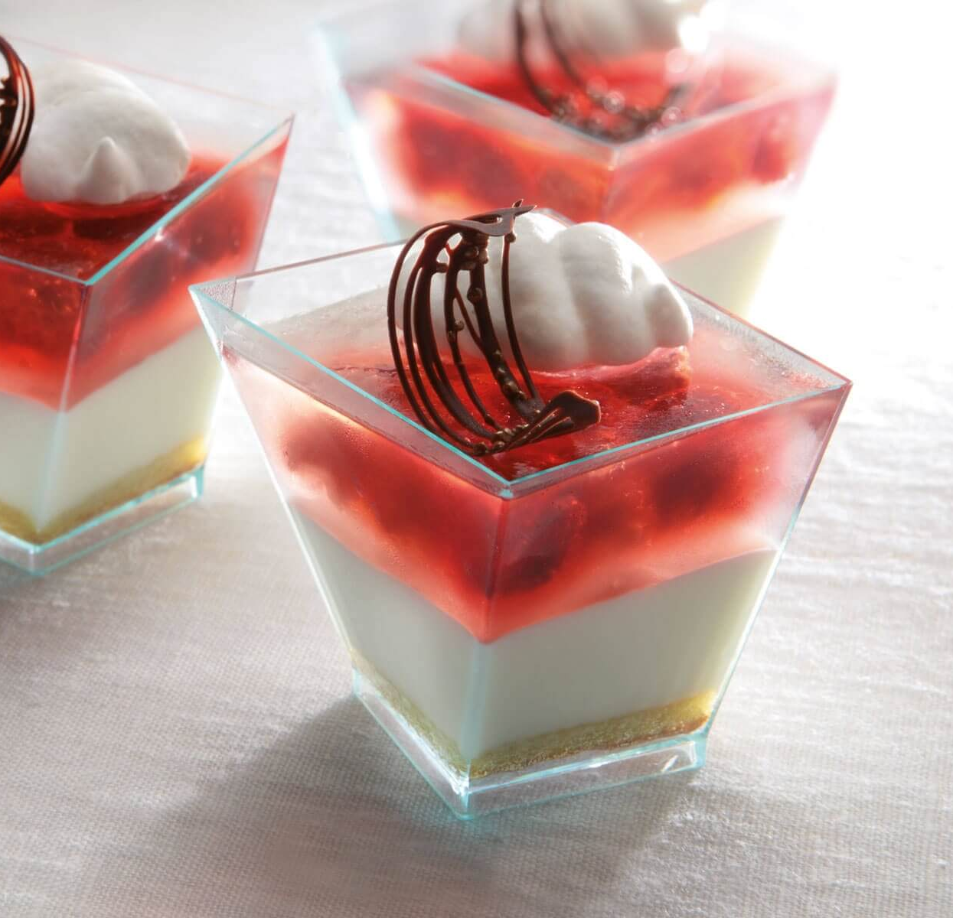

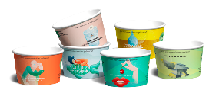
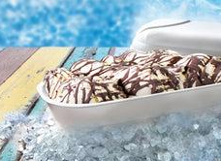
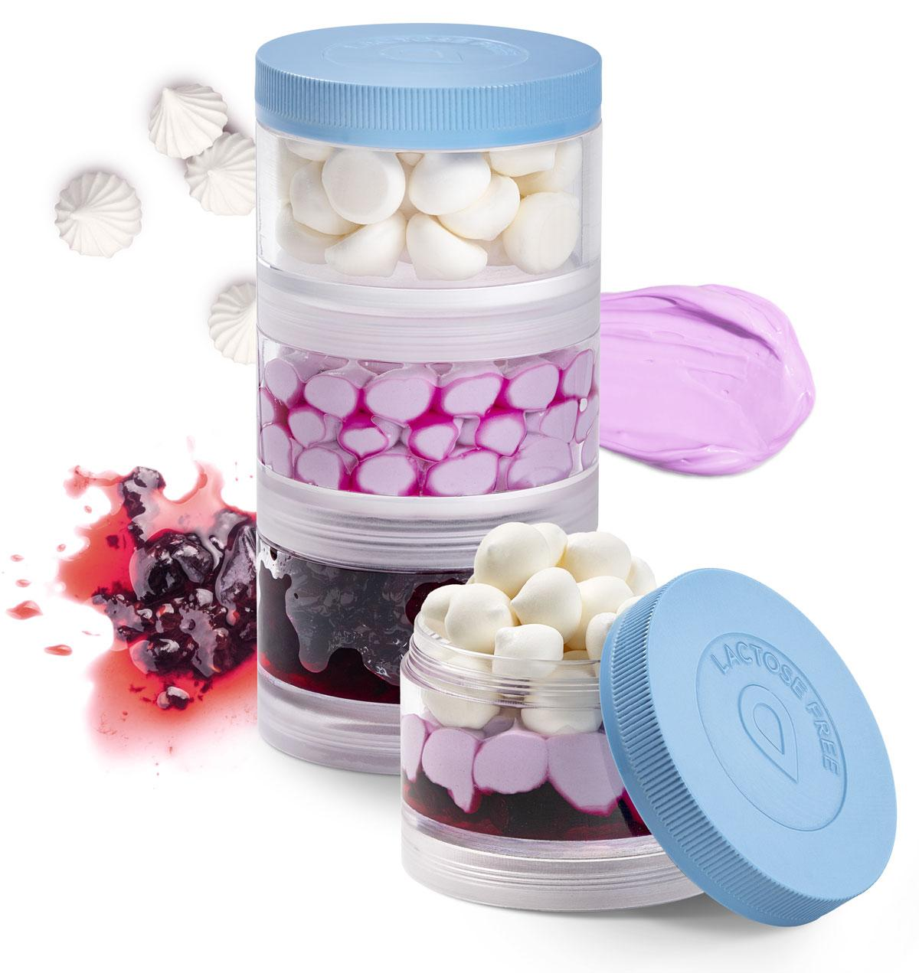
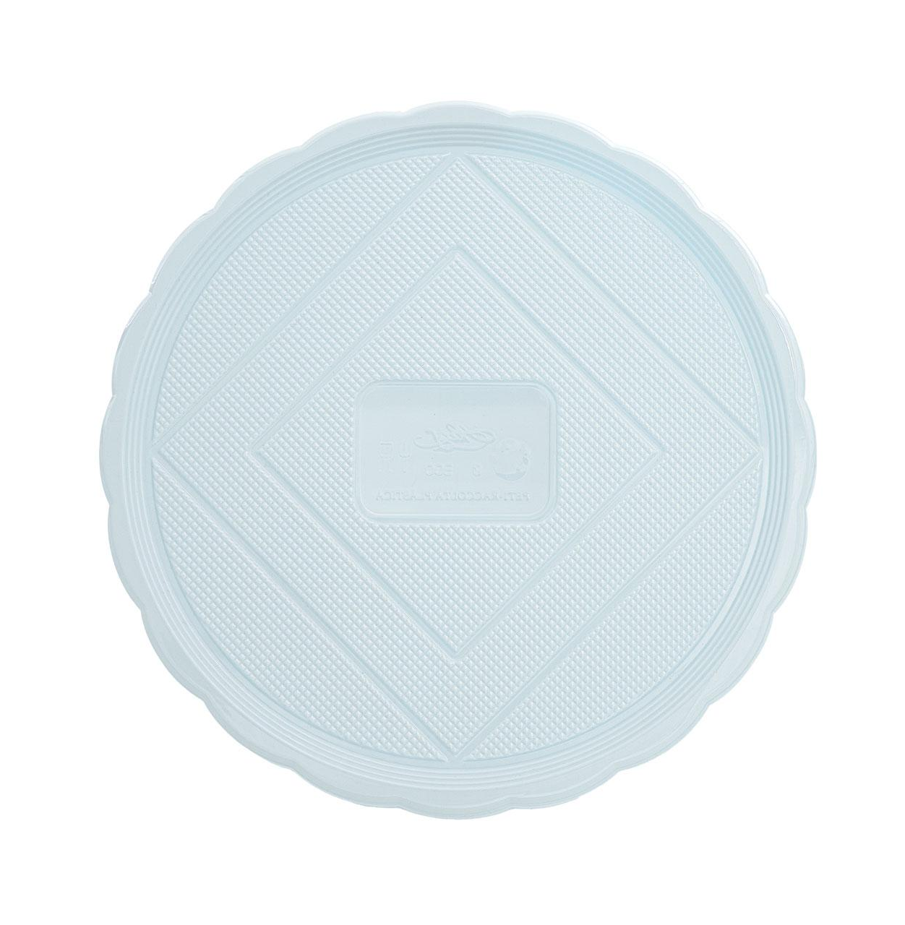

Our products
20 production lines.
Supply silos and 3 raw material transport lines.
Packaging and mixing system for spoons.
Drying system for PLA.
7 thermoforming machines.
2 robot lines.
Offset printing system.
Waste grinding system.
Suppliers of the major ice-cream chains in Italy and abroad.
More than 10 millions pieces produced in a year.
11 machines for internal production of paper cups.
1 production line of customizable paper spoons.
Use of FSC certified paper only.
Production capability of more than 290 mln ice-cream cups.

Slide 5

Our market
Alcas S.p.A has developed its commercial structure over time: 1 sales manager, 4 area managers within the Italian market and 3 area managers for the international market, together with 6 inside sales resources: 3 for Italy and 3 for foreign countries.
This internal structure is reinforced by a national sales network, present all over Italy with around 80 agents.
ALCAS USA
10 year presence
More than 1.000 customers
INTERNATIONAL MARKET
225 distributors
Over 70 countries
NATIONAL MARKET
80 agents
More than 5.000 customers
Around 400 wholesalers

Slide 6








Alcas numbers
At a glance
Sustainability
60
Years
>20
Millions - Turnover
BRC
FSC
Sales
Operations
70
Countries supplied worldwide
5k
Happy customers
38
Production lines
630k
Cartons shipped in 1 year

